Slide 1

Analyze reviews With the help of a.I.
Hasan haq
Notes:
Some ratings systems work better than others
We are focused on Yelp/Amazon 5-star type peer reviews
Cut out a lot of time on title slide

Slide 2
Smart consumers read reviews, but we can’t analyze all of them.
Notes:
We all use yelp for restaurant reviews. Distribution too narrow. Solution is web app to look at text to give a better measure.
Be more concise

Slide 3
Irrelevant
Subjective
Incomplete
Inaccurate
Subjective
Polarized
Source: http://minimaxir.com/2014/09/one-star-five-stars/
Notes:
LESS TIME ON THIS
What does charm and welcome nature really mean?
Bottom line is some reviews are better than others

Slide 4
Let a computer do all the work with Riffle.

Slide 5
Yelp Dataset
4.1mm reviews
144k businesses
USA, UK, Germany, Canada
Proportion of Reviews by Star Ratings
Notes:
Don’t mention the steakhouse thing

Slide 6
Let Riffle Do It
Train on 1 and 5 Star Reviews
Assign Simple Ratings
Add Penalties
Populate SQL Database
Deploy to Web App
Object Oriented Python
F1 Scores
XGBoost: 95%
Naïve Bayes: 93%
Random Forests: 92%
NLTK
TextBlob
AWS
Postgresql
Psycopg2
Flask
WTForms
SQLAlchemy
Apache
WSGI

Slide 7
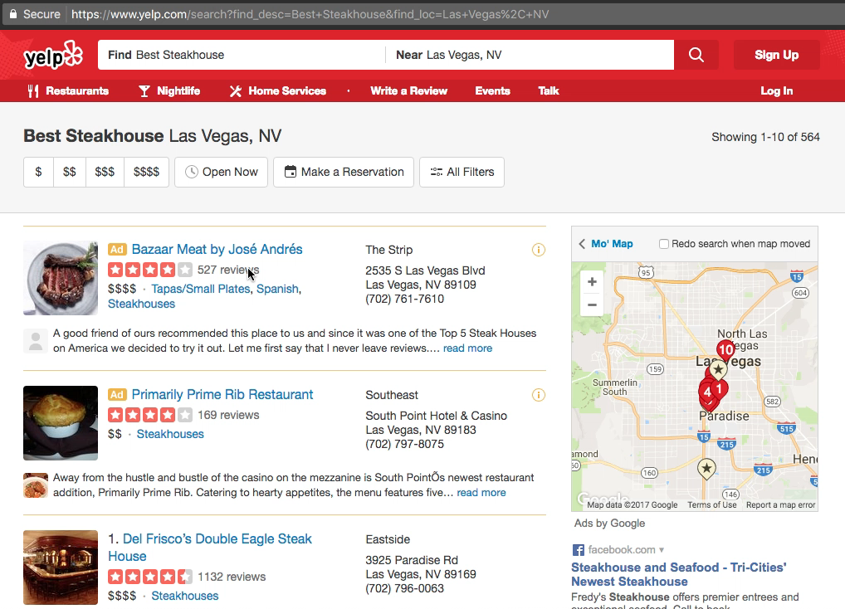
Riffle Product Demo

Slide 8

Thank you!
Hasan Haq
hasan.haq@gmail.com
https://riffle.hasanhaq.com
Notes:
Thanks and come check it out

